Slide 1

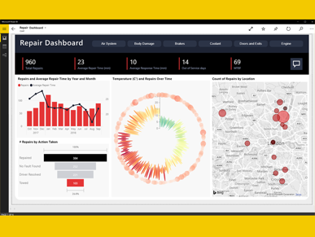
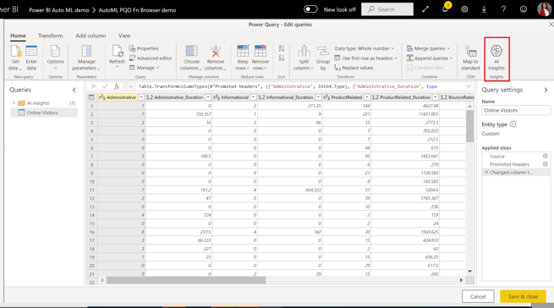
Power BI
Power Platform:
Power BI
Power Apps
Power Automate
Power Virtual Agents
https://powerbi.com
Power BI is a business analytics service by Microsoft.
It allows users to create their own reports and dashboards.
Data can come from SQL databases, spreadsheets, web pages, etc. Business Intelligence (BI) may include time series forecasting, regression, and other ML methods, even AutoML.
There are many tutorials on YouTube, for example:
- https://www.youtube.com/watch?v=TmhQCQr_DCA
Originally designed by Ron George in 2010 as "Project Crescent".
- https://twitter.com/rongeorge
Renamed into Power BI for Office 365 in 2013.
First general public release in 2015.
No-code ML in Power BI is similar to AutoML in Azure ML Studio
Tutorial: Build a Machine Learning model in Power BI
- https://docs.microsoft.com/en-us/power-bi/connect-data/service-tutorial-build-machine-learning-model
Create a dataflow with the input data
Create and train a machine learning model
Review the model validation report
Apply the model to a dataflow entity
Using the scored output from the model in a Power BI report

Slide 2
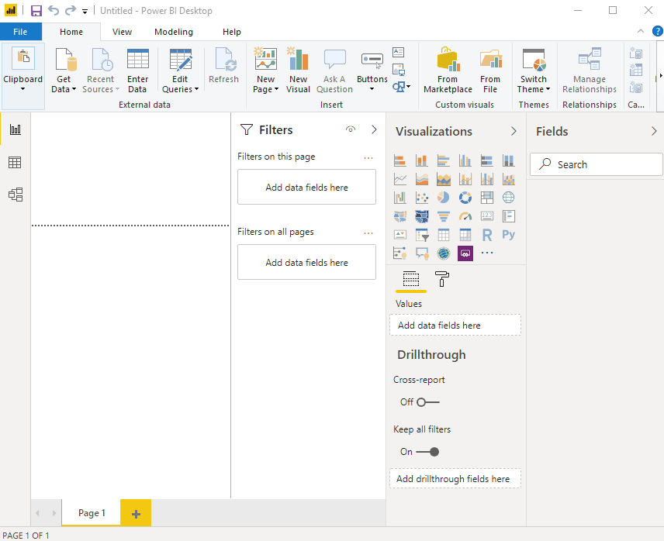
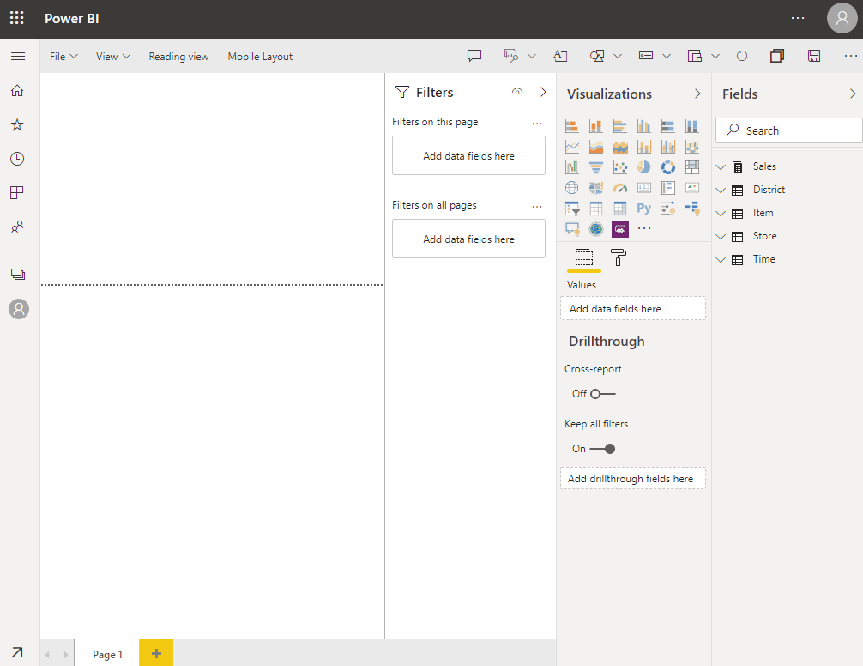
Power BI Online (in browser)
Windows – Desktop app
Power BI Desktop (a.k.a. Designer) is available ONLY on Windows.
If you are on a Mac, your choices are: - https://www.macworld.co.uk/feature/best-virtual-machine-software-3671133/
FREE - Wine ( https://www.winehq.org/ ) or VirtualBox ( https://www.virtualbox.org/ ) https://www.youtube.com/watch?v=J-S_TvtIm5Y
Parallels - $80 - https://www.youtube.com/watch?v=r89fGOM1bq0
Dual Boot (Apple's Boot Camp - free)
Trend.net $9/mo
Azure VM $100/mo
Available in Desktop Designer:
Data transformation, modeling, and shaping
Calculated columns
Python and DAX
RLS creation (row-level security)
DAX = Data Analysis Expressions (available only in Windows Desktop app)
Formula language with functions - similar to Microsoft Excel
Good introduction video:
- https://www.youtube.com/watch?v=waG_JhBgUpM
Measure = <some DAX function>.
Total Number = sum(TabName[ColName])
DAX Studio: https://daxstudio.org/ - free, for Windows, lets you troubleshoot Power BI datasets, see the statistics on them and work on the DAX
Comparison: desktop vs online:
https://spreadsheeto.com/power-bi-desktop-vs-online/#desktop-vs-online
Online service (in browser)
Power BI Service (online) include:
Dashboards
Sharing
RSL management
Gateway connections

Slide 3
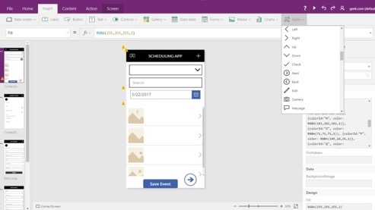
Microsoft Power Apps
Power Platform:
Power BI
Power Apps
Power Automate
Power Virtual Agents
powerapps.com
Good short demo video:
- https://www.youtube.com/watch?v=2RzCbd5XgJg
Power Apps:
rapid application development environment
build custom apps for your business needs
suite of apps, services, connectors, and data platform
responsive design - apps can run in browser, tablet, or phones
https://docs.microsoft.com/en-us/powerapps/
https://powerapps.microsoft.com/en-us/downloads/
https://create.powerapps.com/studio/#
Benefits of Power Apps:
Fast and easy App Creation (responsive custom forms)
Easy Standard Connectors (to data sources ...)
Easy integrate with Office 365, Power BI, SharePoint, ...
Mobile Ready
Microsoft Flow (process and task automation)
Low Cost
Disadvantages:
Separate apps for Android and iOS
Can retrieve only 500-2,000 items
Can't integrate JavaScript
Meant only for internal use (licensing model)
Microsoft Dataverse:
Common Data Service (CDS) has been renamed
to Microsoft Dataverse (2020)
https://docs.microsoft.com/en-us/powerapps/developer/data-platform/entities
CDM = Common Data Model
CDS = Common Data Service = Dataverse
Power Query:
data transformation and data preparation engine
graphical interface for getting data from sources
Power Query Editor for applying transformations
...

Slide 4
Integrate external model to work from Power BI
You can train the model in ML Studio, deploy it as an endpoint, call this endpoint from Power BI.
You can also use Python in Power BI desktop – then you can read model file directly:
-- https://docs.microsoft.com/en-us/power-bi/connect-data/service-aml-integrate
-- https://docs.microsoft.com/en-us/power-bi/connect-data/desktop-python-scripts
-- https://docs.microsoft.com/en-us/power-bi/connect-data/desktop-python-in-query-editor
Microsoft power BI Integration (part 1 of 2) Create the predictive model with a notebook
-- https://docs.microsoft.com/en-us/azure/machine-learning/tutorial-power-bi-custom-model
Microsoft power BI Integration (part 2 of 2) Tutorial: Consume an Azure Machine Learning model in Power BI
-- https://docs.microsoft.com/en-us/power-bi/connect-data/service-aml-integrate?context=azure/machine-learning/context/ml-context
StackOverflow - consuming a deployed Azure ML model in PowerBI
-- https://stackoverflow.com/questions/65899552/consuming-an-deployed-azure-ml-model-in-powerbi
Also – you can use AI Insights:
-- https://docs.microsoft.com/en-us/power-bi/transform-model/desktop-ai-insights
https://docs.microsoft.com/en-us/power-bi/transform-model/desktop-ai-insights#:~:text=Power%20BI%20makes%20it%20simple%20to%20incorporate%20the,to%20the%20BI%20analyst%20using%20the%20Azure%20portal.
or this (deploying onnx models in SQL):
-- https://docs.microsoft.com/en-us/azure/azure-sql-edge/deploy-onnx
Related links:
Premium options: P1 vs P2 vs P3:
-- https://www.encorebusiness.com/blog/power-bi-premium-p1-vs-p2-vs-p3
What are endpoints (preview) - Azure Machine Learning
-- https://docs.microsoft.com/en-us/azure/machine-learning/concept-endpoints

Slide 5
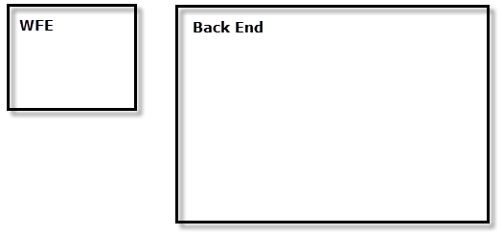
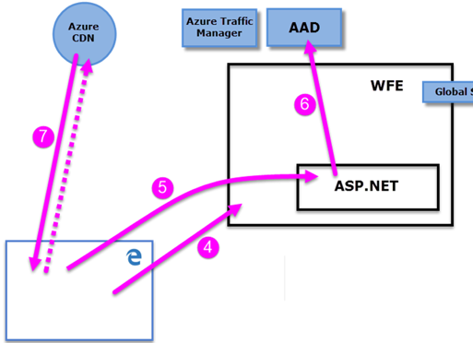
Power BI Architecture
During the login process
Deploying Power BI creates two clusters: a front end and back end.
WFE = Web Front End
Power BI used Azure Active Directory (AAD)
User signs into powerbi.com or app.powerbi.com
Azure Traffic Manager will direct the user to the closest datacenter that Power bi deployed
The user will then be asked to login with the AAD credentials
The user is given a cookie that the login was successful which is then inspected by ASP.NET service inside the WFE
The WFE checks with the AAD service to authenticate the user’s Power BI service subscription
The browser then contact the Azure CDN (Content Delivery Network) to get the necessary files to enable the browsers interaction with the Power BI Service
The user is now able to see the request report or home page of Power BI.

Slide 6
Data Security
When data is at rest, it is stored in an encrypted. For more information, please refer to the Power BI Security Whitepaper: https://docs.microsoft.com/en-us/power-bi/guidance/whitepaper-powerbi-security#data-storage-and-movement A user establishes a connection based on their login and accesses data through their credentials
When a user shares reports, dashboard access to that data is dependent on the data sources having Role Level Security (RLS). Note if RLS is not applied, the original credentials are used to access or display the data
Power BI Models and Security
Direct Query
Direct Query Models will query the data directly from the source
Direct Query Models are slower because the data is not processed into an underlying tabular model
The Data rests in the data source
The Credentials of the user will be passed to the source, so that the source will handle the security
Database security is enforced
Role Level Security (RLS)
Limiting the data by user or role
RLS only works with imported datasets
It does not use data source security roles
You can use these groups:
Distribution Group
Mail-enabled Group
Security Group
Office365 groups CAN NOT be used
Import
Power BI Models that Import data relies on Row Level Security (RLS) to be applied to protect the data
Imported Models uses the original credentials and the security from the sources uses that credential to determine which data gets loaded into the data model
Generally, System Accounts are used that have access to all data and then RLS is applied
If the model’s security uses a User account with limited access to data then the model will only have the data, they have access to, despite the fact a report user may have different access.
Imported Models are generally faster because the data gets processed on a schedule
Composite Models
Composite Models can have both Import tables and Direct Query Tables
Security for each table is maintained like it’s counter part For example, Direct Query tables will use the source security and Import tables will rely on RLS
Import tables are generally your dimension data which changes less frequently
Direct Tables are generally your fact data or transaction data that changes more frequently
Analysis Service
Azure Analysis Service (AAS) relies on AAD to access the data
It has import and direct query options
The same pattern applies, direct query will pass to the source with AAS just being a metadata repository
Most implementations of an Analysis Tabular models are import and they have RLS that has been implemented.

Slide 7
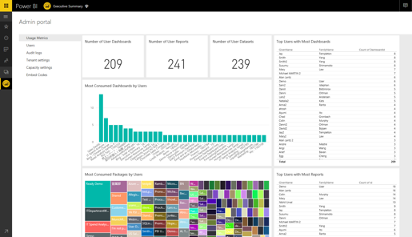
Power BI Admin portal
The admin portal includes items such as usage metrics, access to the Office 365 admin center, tenant management and settings.
The admin portal is accessible to all users who are Global Admins in Office 365 or have been assigned the Power BI service administrator role.

Slide 8
Power BI Admin Portal | Usage Metrics
Distinct count of all dashboards, reports, and datasets in the user workspace
Most consumed dashboard by number of users who can access it.
The most popular content users connected to. This would be anything the users could reach through the Get Data process, so SaaS content packs, Organizational content packs, files or databases

Slide 9
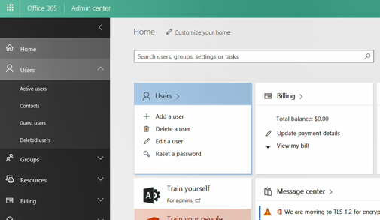
Users
User management, for Power BI, is done in the Office 365 admin center, so this section allows you to quickly reach the area to manage users, admins, and groups within Office 365.

Slide 10
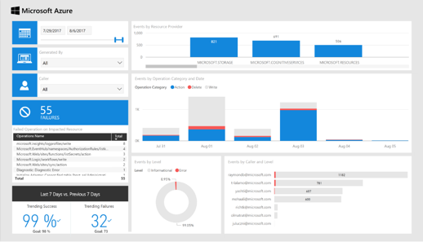
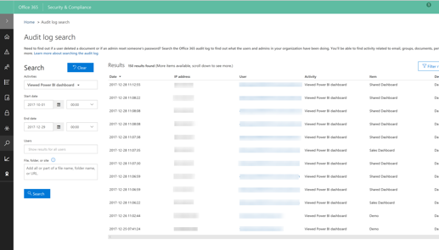
Audit logs
The logs are located within the Office 365 Security & Compliance center.
This section allows you to quickly access that area within Office 365.
Log analytics app from AppSource
Reference docs for more info: https://docs.microsoft.com/en-us/power-bi/service-admin-auditing

Slide 11
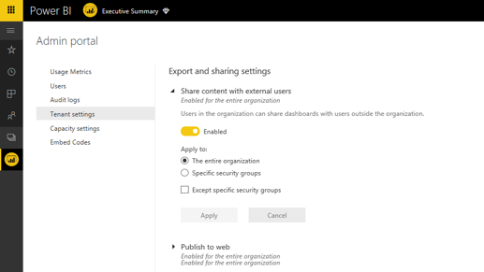
Tenant settings
Tenant settings give you granular control over what features are made available to your organization
Settings:
Share content with external users
Publish to web
Export data
Export reports as PowerPoint presentations
Print dashboards and reports
Publish content packs and apps to the entire organization
Create template organization content packs and apps
Ask questions about data using Cortana
Use Analysis in Excel with on-premises datasets
Use ArcGIS Maps for Power BI
User global search for Power BI
Integrate with and share R visuals
Create audit logs for internal activity auditing and compliance
Usage metrics for content creators
Per-user data in usage metrics for content creators
Data classification for dashboards
Embed in apps
Notes:
Tenant settings give you more control over what features are made available to your organization. If you have concerns around sensitive data, some of our features may not be right for your organization, or you may only want a given feature to be available to a specific group. If this is the case, you can switch it off in your tenant.
https://powerbi.microsoft.com/en-us/blog/announcing-granular-tenant-settings-in-power-bi/
https://docs.microsoft.com/en-us/power-bi/service-admin-portal

Slide 12
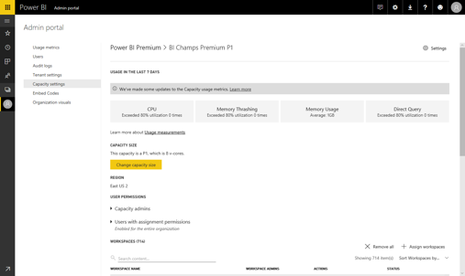
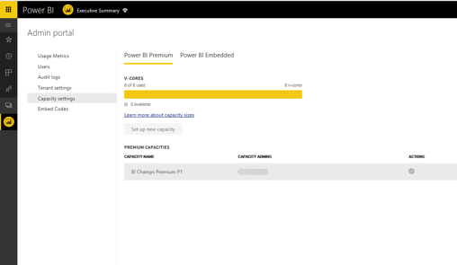
Capacity settings
The Premium settings tab allows you to manage any Power BI Premium and Power BI Embedded capacity that has been purchased for your organization.
All users within your organization will see the Premium settings tab, but will only see contents within it, if they are assigned as either Capacity admin or a user that has assignment permissions.
Notes:
The Premium settings tab allows you to manage any Power BI Premium and Power BI Embedded capacity that has been purchased for your organization.
All users within your organization will see the Premium settings tab, but will only see contents within it, if they are assigned as either Capacity admin or a user that has assignment permissions.

Slide 13






IT capabilities
Whitelisting
Full auditing capabilities
Capacity admin can allow specific users to use capacity when needed.
Office 365 admin can access audit logs that capture information about Premium capacities.
Capacity admin grants access
Pro user w/permissions
increase capacity
Office 365 admin can review change in audit log
Dedicated
Shared
Dedicated
HR Workspace
Finance Workspace
Sales Workspace
Sales Workspace

Slide 14
Permissions
Two levels of assignment permissions
Capacity admins
Power BI Pro user with assignment permissions
Add capacity
Assign admins
Granting workspace permissions
Bulk assign workspaces to capacity
Remove workspaces from capacity
Monitor capacity usage
Assign workspaces to capacity
Grant other Pro users access to their capacity workspace
Notes:
KEY POINTS:
There are two levels of permissions to manage content in Power BI Premium dedicated capacity.
You can now specify individuals with assignment permissions.
TALK TRACK
I mentioned two levels of permissions… one is your capacity admin. They can add capacity, assign admins, and assign and remove workspaces.
Capacity admins can also grant permissions to a workspace, increase capacity, do monitoring, logging and auditing.
And the other permission level is a Power BI Pro user with assignment permissions who are typically the people authoring reports…they can assign workspaces to capacity. This means they can move their workspace to the dedicated capacity and can also grant other Pro users access to that capacity workspace. So, if I'm a Pro user, and I have assignment permissions, I can be working on a project, realize that I need to work with some other Pro users, then give those other Pro users access to that workspace, so everyone can collaborate on the content, reports, dashboards, etc. Then we can move the workspace to dedicated capacity to share it with a broader set of Power BI users.

Slide 15
Managing Power BI Premium Content
Permissions
Management
Workspaces
Capacity
Two levels of assignment permissions
Work with a consistent management experience
Easily assign workspaces
Move content from shared to dedicated capacity
Notes:
KEY POINTS
Permissions – there are two level of permissions for Premium. Capacity admin and Pro users with assignment permissions. Assign admins and capacity owners
Management - Work with a consistent management experience and use the same Power BI Pro admin portal. Assign admins and capacity owners
Workspaces – Easily assign workspaces and share dedicated workspaces by granting permission.
Capacity – Move content from shared to dedicated capacity. Monitor usage and easily increase if needed.
TALK TRACK
We will look at how you manage capacity in Power BI. We’ll cover four areas…permissions, management, workspaces, and capacity.
Power BI Premium supports two levels of permissions. The first is for Pro users with assignment rights, which is another way of saying site admins, and the second is for the capacity admins or capacity owners.
Management is handled using the exact same Power BI Pro admin portal, so you’ll have a consistent management experience. It’s through the admin portal where admins can assign capacity to owners.
Just as the management interface hasn’t changed, the workspaces are also unchanged making it easy to assign workspaces and grant permissions. And in Power BI , you can easily see the difference between regular workspaces and those with Premium capacity.
Finally, managing your capacity is easy. You can move content from shared to dedicated and back again. You can monitor the usage of it, and increase that capacity as needed.
That was a quick overview, but now we’ll dive in a little deeper on each management area.

Slide 16
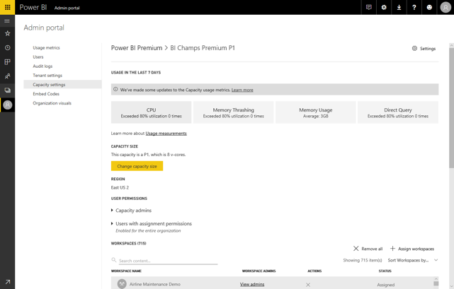
Management
Work with a consistent management experience
Capacity admin
Pro user with assignment permissions
All administrative actions for Power BI Premium in one place – the Power BI admin portal
Manage the capacity owner list
Notes:
KEY POINTS:
Power BI Premium is managed though the same Power BI admin portal to provide a consistent management experience.
A new setting for managing Power BI Premium dedicated capacity has been added.
Assign admin and capacity owners
TALK TRACK
Now, we’ll go through some of the capabilities that I just showed you. This screenshot shows the admin portal, which has essentially stayed the same. You've got metrics like manage users and audit logs, but now the navigation pane on the left includes a setting for managing capacity. So, you can see it’s the same admin portal, but just with a new setting added to the bottom of the list. The overall management experience remains consistent with the one that you are used to.

Slide 17
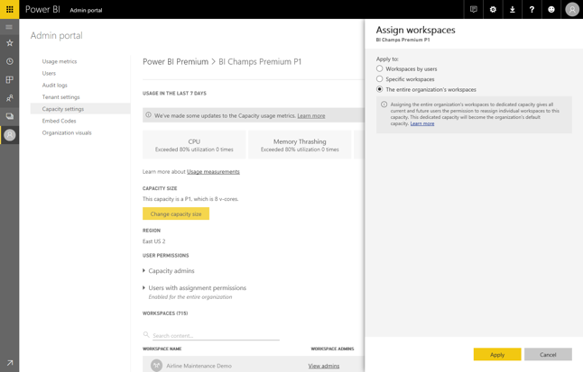
Workspaces
Assign workspaces to dedicated capacity
Capacity admin
Pro user with assignment permissions
Migrate the entire organization workspaces
Migrate specific users' workspaces to capacity
Migrate specific workspaces to capacity
Notes:
KEY POINTS:
When assigning the entire organization’s workspaces, you are granting workspace assignment permissions to all current and future users. This dedicated capacity will become the organizations’ default capacity.
Assigning users’ workspaces to dedicated capacity also grants these users workspace assignment permissions. This means they can move workspaces in and out of dedicated and shared capacities.
Grant permission for the entire organization, enabling a subset or whole org, to access a dedicated workspace whether they are a Pro or Basic user.
TALK TRACK
Here, we see how you go about assigning workspaces in the Power BI admin portal. When you have capacity and first go through to the setup process, you have a couple of options:
The first option is to move the whole organization’s workspaces. You might do this because you want everyone to be on dedicated capacity. In this case, you're purposefully granting workspace assignment permissions to all current and future users, so that dedicated capacity will become the organization's default.
The second option is to migrate just specific user workspaces to capacity. Assigning users to dedicated capacity only grants these users the workspace assignment permissions. This means they can move the workspaces in and out from dedicated to shared.

Slide 18
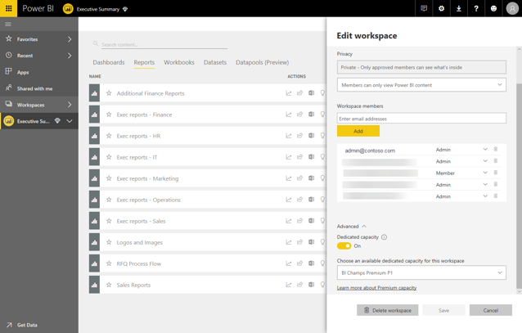
Capacity
Move content from shared to dedicated capacity
Capacity admin
Pro user with assignment permissions
Easy to identify workspaces with Premium
Seamlessly move content from Capacity to Shared and back again
Notes:
KEY POINTS:
With Power BI Premium, you can easily move content to the appropriate capacity based on changing needs.
To move capacity you have to be an admin of the workspace as well.
Easily visualize the usage of your dedicated capacity from the Power BI admin portal.
TALK TRACK
Both capacity admins as well as pro users with assignment permissions can move content from shared to dedicated capacity. So, if I'm a Power BI Pro user that's been given assignment permissions, I will see my workspaces when I log into Power BI. Those workspaces with an icon by them make it easy to see which ones are identified with Premium dedicated capacity. To move a workspace from dedicated to shared or vice versa is as easy as selecting the workspace and then clicking the toggle switch.

Slide 19
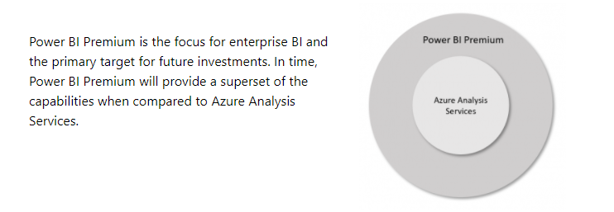
Power BI Premium is the future
https://powerbi.microsoft.com/en-us/blog/power-bi-premium-and-azure-analysis-services/#:~:text=The%20table%20below%20lists%20where%20the%20significant%20differences,%20%20Yes%20%2011%20more%20rows%20

Slide 20
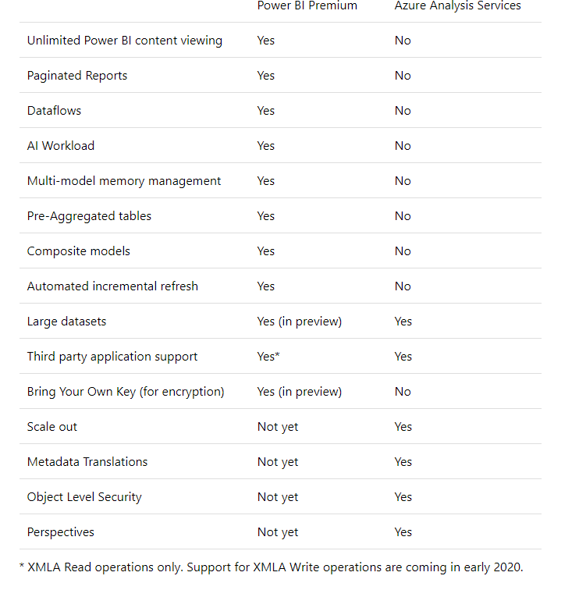
Feature Comparison

Slide 21
Capabilities found in Power BI Premium and not AAS
Unlimited Power BI Desktop authoring
Aggregations – pre-aggregated tables in Power BI optimize query performance for direct query models on large data.
Multi-model memory management – The total size of models in AAS cannot exceed the memory available in the chosen configuration. In Power BI Premium, models are loaded in memory as required and evicted when not in use providing a more efficient use of memory resources.
Composite models are individual datasets that support tables with direct query, import, or both – all in a single dataset.
Incremental refresh policies – no-code incremental refresh can be configured simply and easily.
Scheduled refresh is available in Power BI Premium with a couple clicks – this requires code in Analysis Services.
Bring Your Own Key gives you the ability to control the encryption keys for your Power BI data at-rest.

Slide 22
Capabilities not available in premium
Backup/Restore
Object Level Security
Scale-out Read Replicas
Pause/restart (available in Power BI embedded)
Alias server names
Asynchronous Refresh (via REST APIs)

Slide 23
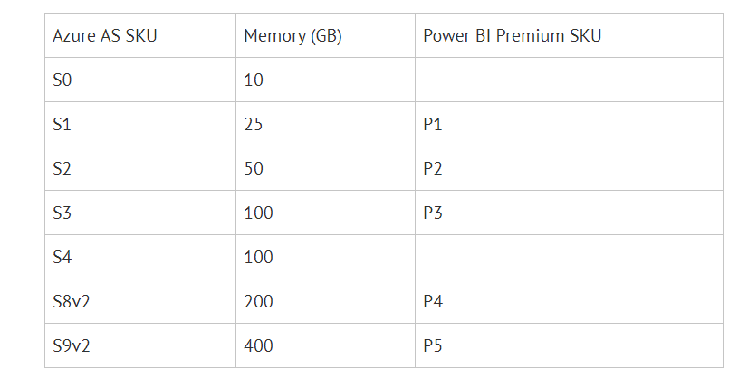
AAS to SKU

Slide 24
Collaboration
Workspaces
Apps

Slide 25
Power BI App Workspace
A share group workspace to collaborate on creation of Power BI Apps
“An App Workspace is a distinct area, separate from My Workspace, which is dedicated to a specific team, subject area, or project. Power BI and Excel reports are published to an App Workspace so that colleagues can view the content, and contribute as appropriate”
Power BI Service
App Workspace
Dashboards
Reports
Datasets
My Workspace
Dashboards
Reports
Datasets

Slide 26


Power BI Apps
A group of reports and dashboards targeted to a specific group of users
“A Power BI App is a set of packaged up content in the Power BI Service for the purpose of distributing related reports and dashboards to a larger base of consuming users.”
App Workspace
Dashboards
Reports
Datasets
Power BI App
Dashboards
Reports
Datasets
Content
Creator Team
Create/Publish
View Only
Users

Slide 27
Workspace Security Roles
Admin
Member
Contributor
Viewer

Slide 28
Admin and Member Roles
Admins can do everything
Members can do the same, with the following exceptions:
They can not up update or delete the workspace (e.g. name)
Add or remove users
Allow users to update the app for the workspace

Slide 29
Contributor Role
Main function of this role is to create, edit and delete content in the workspace
They’re do not have the ability to share content
Can’t update a Power BI App (unless allowed)
They can set up dataset refreshes
They can manage gateways (with permission)

Slide 30
View Role
This role only allows the user to view and interact with a report in the workspace

Slide 31
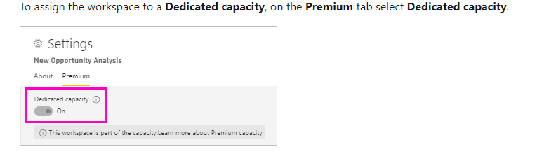
Creating a Workspace on a Capacity

Slide 32
Power BI Usage Scenarios
Personal BI
Small Team Collaboration
Large Team Collaboration and Distribution
Centralized Reporting and Data Warehousing
Data Model Modes

Slide 33
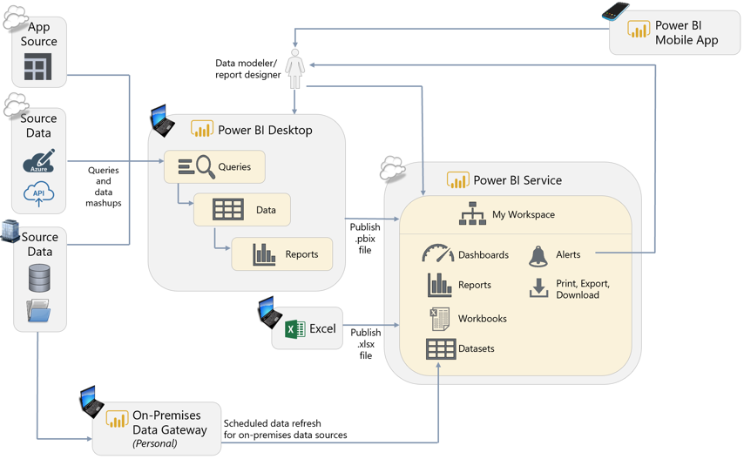
Personal BI
Notes:
Power BI Service w/ Free Power BI license
This model provides the basis for all other models to build from
No sharing or collaboration for free
On-Prem Data Gateway: Personal
Mobile Apps work for “My Workspace”

Slide 34
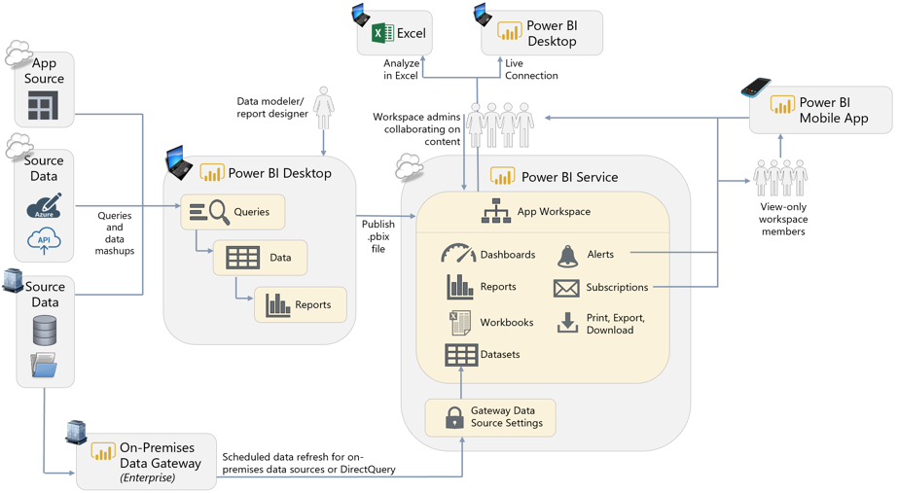
Small Team Collaboration
Notes:
Power BI Service w/ Pro Power BI license
Shared App Workspace to collaborate on content development
No sharing or collaboration for free
On-Prem Data Gateway: Enterprise, can update or do DirectQuery (live)

Slide 35
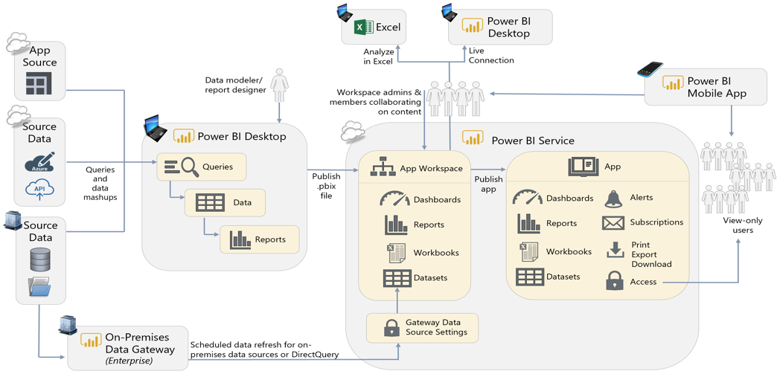
Large Team Collaboration and Distribution

Slide 36
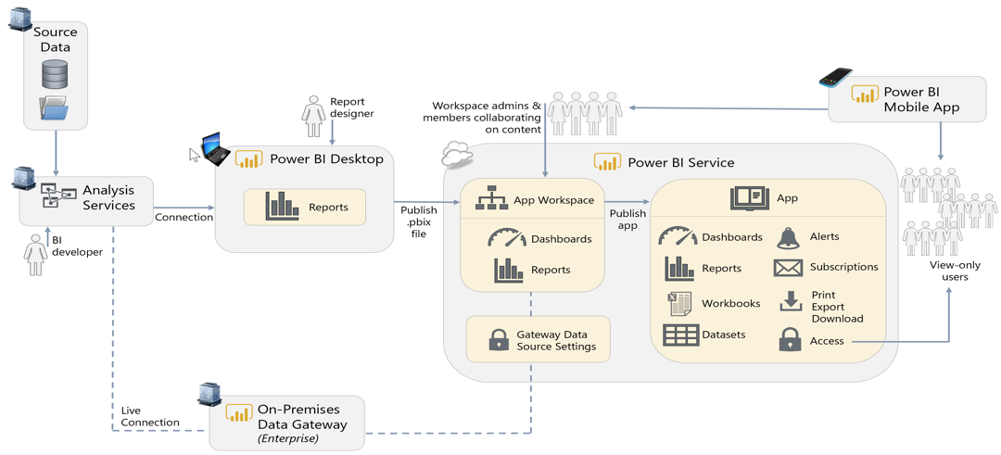
Centralized Reporting and Data Warehousing
Notes:
Analysis Services. Having a centralized, user-friendly, semantic layer such as Analysis Services helps organizations work towards achieving “one version of the truth” and reduces duplicative copies of datasets. For companies which have made an investment in a semantic layer, Power BI can take advantage of it. Depicted above is an on-premises SQL Server Analysis Services, along with an On-Premises Data Gateway. Azure Analysis Services, a PaaS offering in Azure, is a viable alternative as well.
This use case can be satisfied with DirectQuery functionality (for a relational data source like a data warehouse) or a live connection (for an Analysis Services data source which serves as a semantic layer). In Corporate Reporting scenarios, it is valuable to have the data remain in a centralized system, and not loaded to Power BI, as shown in the above diagram. We recommend educating users to think carefully before choosing to import data into Power BI, particularly when the source data resides in a semantic layer such as Analysis Services.

Slide 37
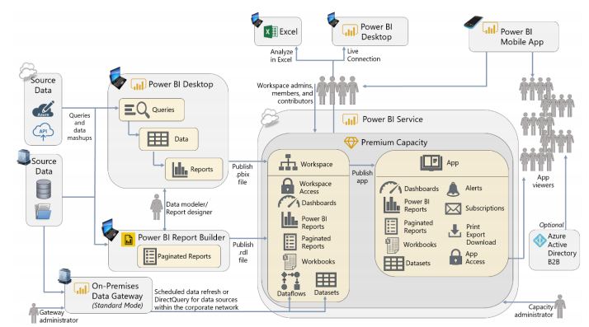
Enterprise Content Distribution
Notes:
Analysis Services. Having a centralized, user-friendly, semantic layer such as Analysis Services helps organizations work towards achieving “one version of the truth” and reduces duplicative copies of datasets. For companies which have made an investment in a semantic layer, Power BI can take advantage of it. Depicted above is an on-premises SQL Server Analysis Services, along with an On-Premises Data Gateway. Azure Analysis Services, a PaaS offering in Azure, is a viable alternative as well.
This use case can be satisfied with DirectQuery functionality (for a relational data source like a data warehouse) or a live connection (for an Analysis Services data source which serves as a semantic layer). In Corporate Reporting scenarios, it is valuable to have the data remain in a centralized system, and not loaded to Power BI, as shown in the above diagram. We recommend educating users to think carefully before choosing to import data into Power BI, particularly when the source data resides in a semantic layer such as Analysis Services.

Slide 38
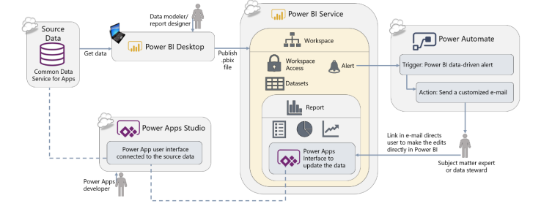
Workflow Automation
Notes:
Power Automate. Power Automate is a Power Platform service for workflow automation between services. Used in conjunction with alerts in Power BI, Power Automate can be used for many types of workflow automation, such as: • Send a customized e-mail alert or text message • Create task in tools such as GitHub, Trello, or a SharePoint list • Post a message on forums such as Teams or Slack • Request an approval • Trigger another workflow In the above diagram, Power Automate is being used to send a detailed, data-driven message to the subject matter expert once the Power BI alert has triggered the Flow in Power Automate to kick off. There are many, many interesting use cases that can be done with Power BI and Power Automate. Power Apps. Power Apps is a Power Platform service for creating small line of business applications and user interfaces in a low-code way. Power Apps can be used for many things, such as: • Task and issue tracking • Budget input • Cost estimations • Surveys Within the e-mail message shown in the above diagram, a URL is provided which directs the recipient back to the Power BI service to make the data updates – this is for user convenience since the user is frequently in the Power BI service anyway. The user interface being exposed in Power BI is backed by Power Apps, so the data updates could certainly be made directly in Power Apps if preferred. When updates are done via the interface in Power Apps, the source data is immediately updated; the updates will be reflected in Power BI the next time a data refresh operation is executed – or DirectQuery could also be used. There are many interesting use cases for integrating Power Apps into Power BI, as well as the inverse where Power BI is integrated into a Power App.

Slide 39
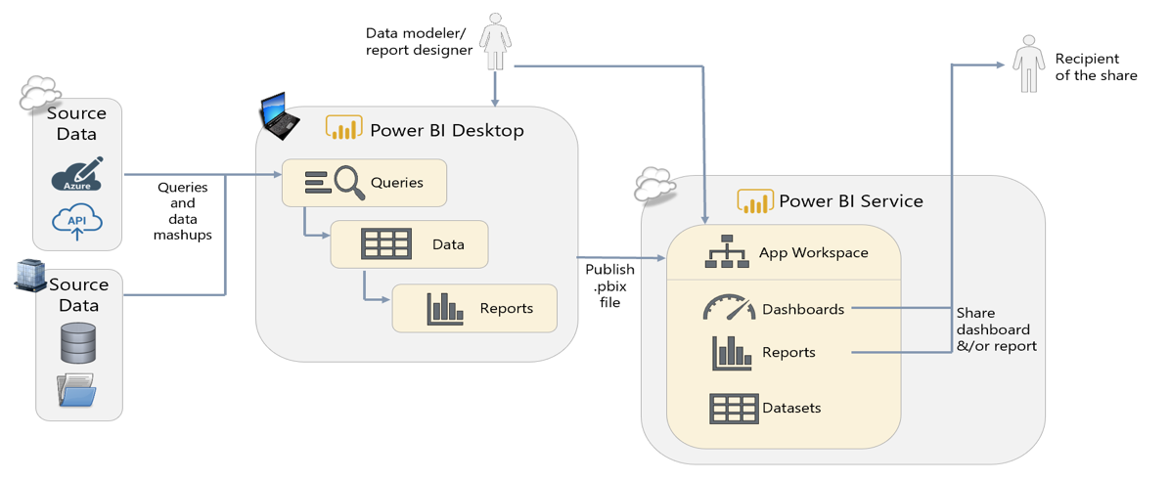
Prototyping Activities and Sharing

Slide 40
Power BI Delivery and Governance
Factors of Adoption
Delivery Approaches
Measuring Adoption

Slide 41
Factors of Adoption
Overall data culture vision
An overall corporate vision to be data driven
Corporate Sponsorship
C-level or line of business heads which support data-driven decision making
Power BI Champions
Champions to evangelize the vision of highly valuable reports and dashboards
Measure Adoption
Usage of reporting on reporting to see what’s working and identify champions

Slide 42
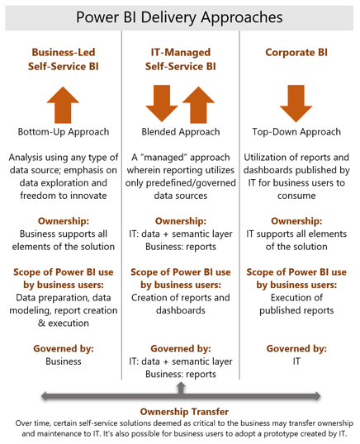
Power BI Delivery Approaches
More
procedural
Corporate BI
IT-Managed Self-Service BI
Business-Led Self-Service BI
Requires tighter, more thorough controls
More agile
Less controls

Slide 43
Business-Led Self-Service BI Workflow
3
Recommend using OneDrive for Business / SharePoint to version PBIX report files
Create 1 folder per App Workspace
Create sub-folder for in progress work
Create sub-folder for what is published in App
Once changes are verified, Power BI App is published for update
1
Team creates all dashboards, reports and datasets in the App Workspaces
App Workspace
Dashboards
Reports
Datasets
Power BI App
Dashboards
Reports
Datasets
Content
Creator Team
Users
Recommended for Usage Scenarios:
Personal BI/ Prototyping
Small Team Collaboration
Recommended dataset storage modes:
Import
DirectQuery
Hybrid/Composite
2
Team reviews, validates dashboards, reports and dashboards with SMEs who have read-only access to the App workspace
Notes:
Separate App Workspaces into functional areas
Base access on “need to know” and security
Leverage Enterprise gateway when possible

Slide 44

IT Managed Self-Service BI Workflow
2
4
Team creates all dashboards, reports in the App Workspaces
Recommend using OneDrive for Business / SharePoint to version PBIX report files
Create 1 folder per App Workspace
Create sub-folder for in progress work
Create sub-folder for what is published in App
Once changes are verified, Power BI App is published for update
App Workspace
Dashboards
Reports
Datasets
Power BI App
Dashboards
Reports
Datasets
Content
Creator Team
Users
Recommended for Usage Scenarios:
Personal BI/ Prototyping
Small Team Collaboration
Large Team Collaboration and Distro
IT BI Team
Recommended dataset storage modes:
Import
DirectQuery
Hybrid/Composite
Live Connection
Streaming
3
BI and Business reviews, validates reports and dashboards with SMEs who have read-only access to the App workspace
1
IT creates all datasets in the App Workspaces
Notes:
Benefit here, is greater centralization and governance around datasets and their management, while retaining “ownership” with the business for reports and dashboards

Slide 45


Corporate BI Workflow
4
Once changes are verified, Power BI App is published for update
Recommend using GitHub or VSTS for versioning of reports and datasets
Create PowerBI templates to save on storage space
App Workspace
Dashboards
Reports
Datasets
Power BI App
Dashboards
Reports
Datasets
IT BI Team
Users
1
Recommended for Usage Scenarios:
Personal BI/ Prototyping
Small Team Collaboration
Large Team Collaboration and Distro
IT creates all datasets, dashboards and reports in the App Workspaces
Recommended dataset storage modes:
Import
DirectQuery
Hybrid/Composite
Live Connection
Streaming
3
BI and Business reviews, validates reports and dashboards with SMEs who have read-only access to the App workspace
Notes:
Benefit here, is greater centralization and governance around datasets and their management, while retaining “ownership” with the business for reports and dashboards

Slide 46
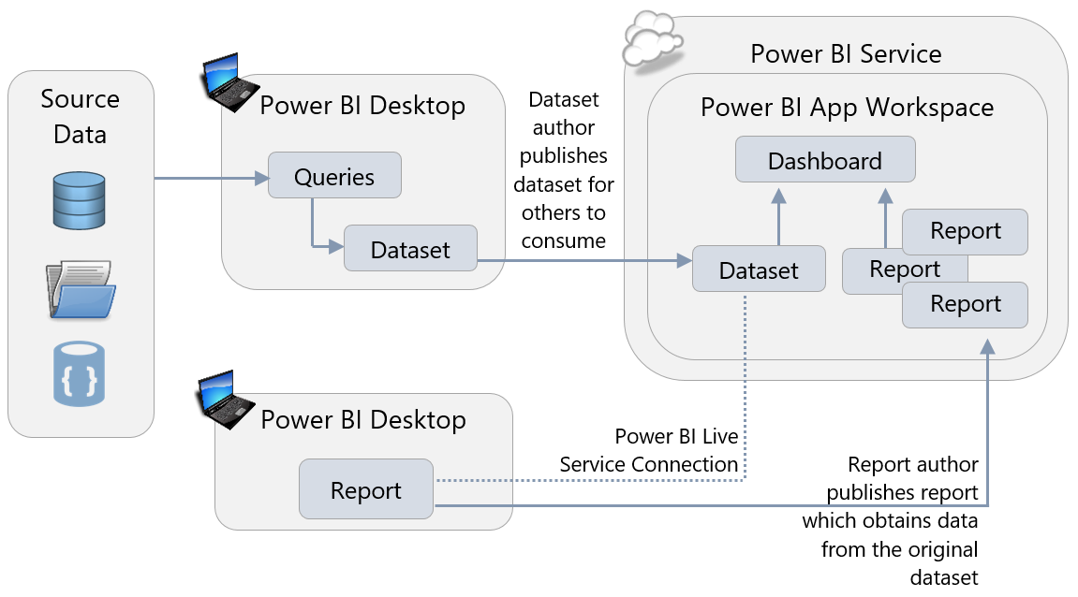
Verified Datasets

Slide 47
Alternative Workflow for IT Managed Self Service and Corp. BI
Tip: Copy API can also be used to “backup” Production App workspaces to Blob storage
Development
Test
Production
App Workspace
Dashboards
Reports
Datasets
App Workspace
Dashboards
Reports
Datasets
App Workspace
Dashboards
Reports
Datasets
Power BI App
Dashboards
Reports
Datasets
Users
Copy objects through API Automation from Dev -> Test -> Prod
Allows for automated deployment of changes
Datasets can be configured to point at different physical environments
Copy API
Notes:
Benefit here, is greater centralization and governance around datasets and their management, while retaining “ownership” with the business for reports and dashboards

Slide 48
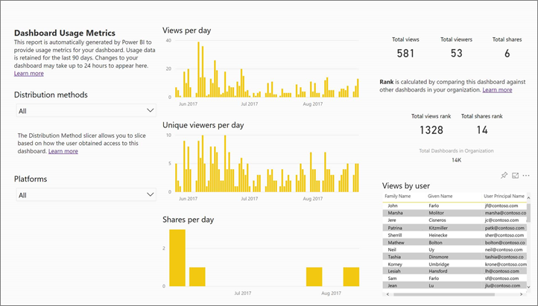
Measuring Adoption
https://docs.microsoft.com/en-us/power-bi/service-usage-metrics

Slide 49
Data Flows

Slide 50
Dataflows: Evolving BI
Self-Service ETL
Provides a way to transform data to be used in reporting
Like Excel, users can extract data, transform it so that multiple datasets can use it
Using the Power Query editor, business users can do the following:
Connect to data sources and ingest tables of data
Create new computed columns in the tables
Join tables together
Filter and aggregate the tables
Union tables
Pivot a table
Train and apply AI models on the tables
And much more!

Slide 51
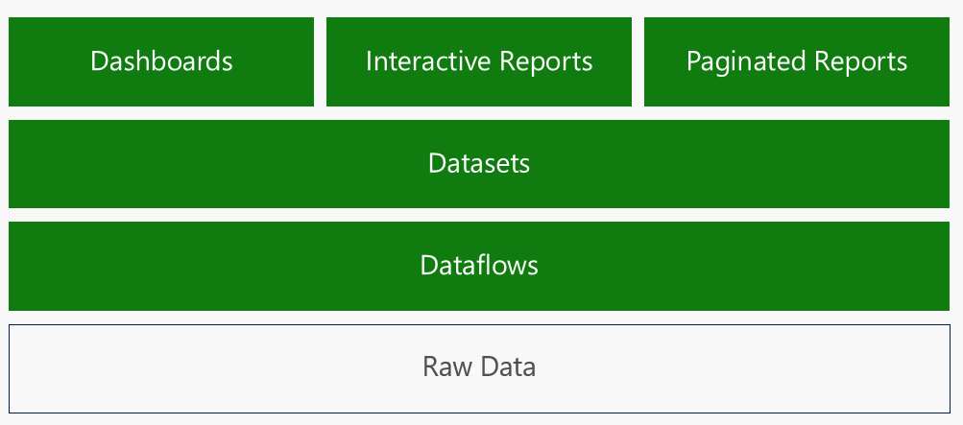
Power BI Information Hierarchy

Slide 52
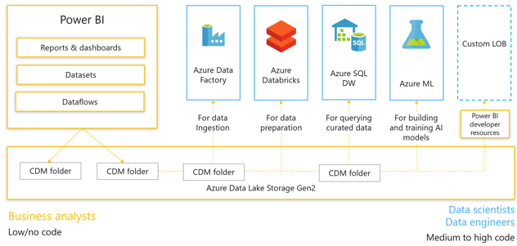
Dataflow and “Bring your own Storage”
Currently in preview
Dataflows by default will store the data in an underlying data lake within Power BI
This data lake is NOT accessible to users
This data lake is managed by the Power BI engine
Companies can now attach a data lake storage account to workspaces and data flows to store the lake
The data is stored in a Common Data Model format
The advantage to this is that transformed data will reside in an organizations data lake this is now accessible to Data Scientists and others who need this data but don’t have a way to transform it.

Slide 53
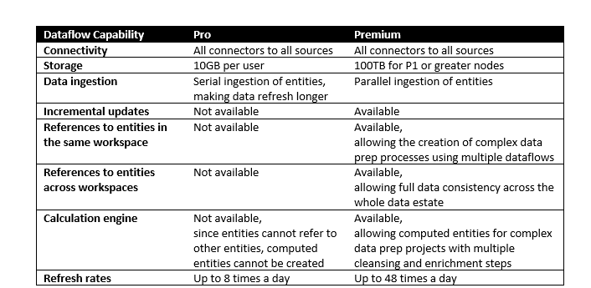
Dataflows – Pro vs Premium features
Please note: Creating report using Power BI desktop using a data flow as the source can only be done in a premium workspace.
Reports can always be done in the service for pro users.

Slide 54
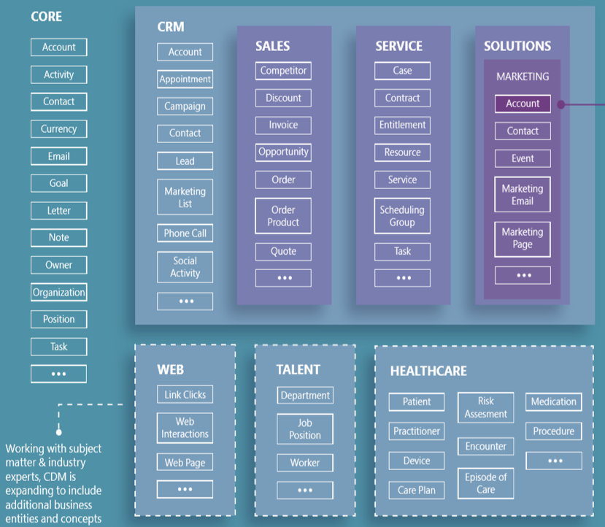
The Common Data Model (CDM) provides modular, and extensible business entities (Account, Lead, Opportunity, etc.) It unifies data in a well-known schema with semantic consistency across applications and deployments. ​ Customers, system integrators, and ISVs can develop turnkey business and intelligence applications, that share data based on these CDM entities. They can also extend entities to capture additional business-specific ideas.​ aka.ms/cdmposter
Common Data Model (CDM)

Slide 55

Dynamics 365 Apps
PowerApps
Power BI Apps
CDS for Apps
Power BI
Integration
Intelligence
ADLS v2
Enrichment and AI
Data Integration
Common Data Model

Slide 56
Power BI Recap
Reports & dashboards
Datasets
Dataflows
Storage
Notes:
Power BI users can now easily create dataflows to prepare data in a centralized storage, using a standardized schema, ready for easy consumption, reuse, and the generation of business insights. Data is stored in Azure Data Lake Store gen2, and is integrated with Power BI and Azure data services. Dataflows are available to Pro and Premium customers.

Slide 57
Data Storage Modes
There are five different ways Power BI can connect to the data needed for a report:
Importing data
Live connection to Analysis Services
DirectQuery mode
Composite models
Real-time streaming dataset (aka push datasets)

Slide 58
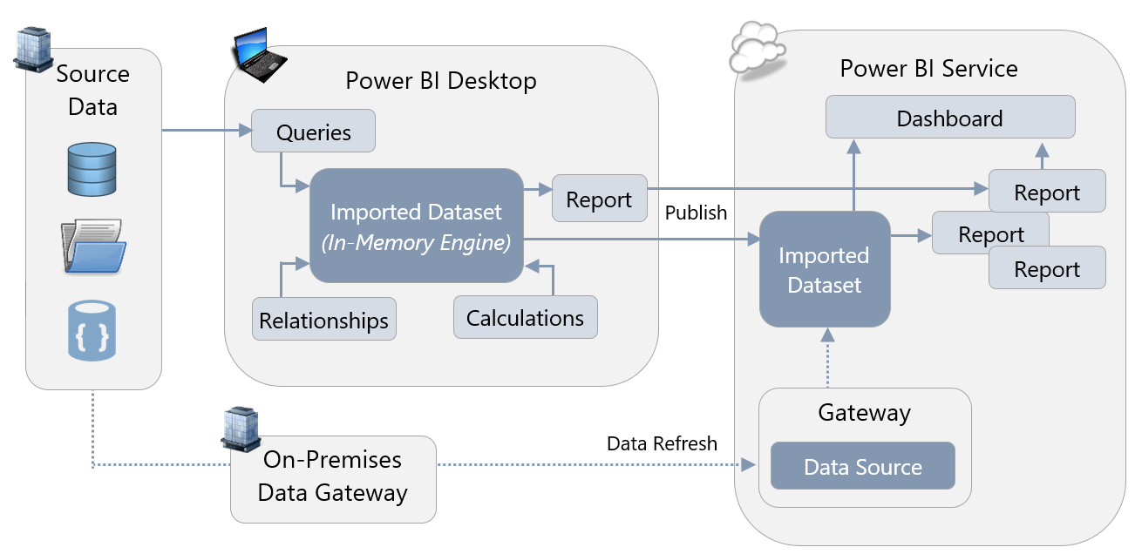
Importing data

Slide 59
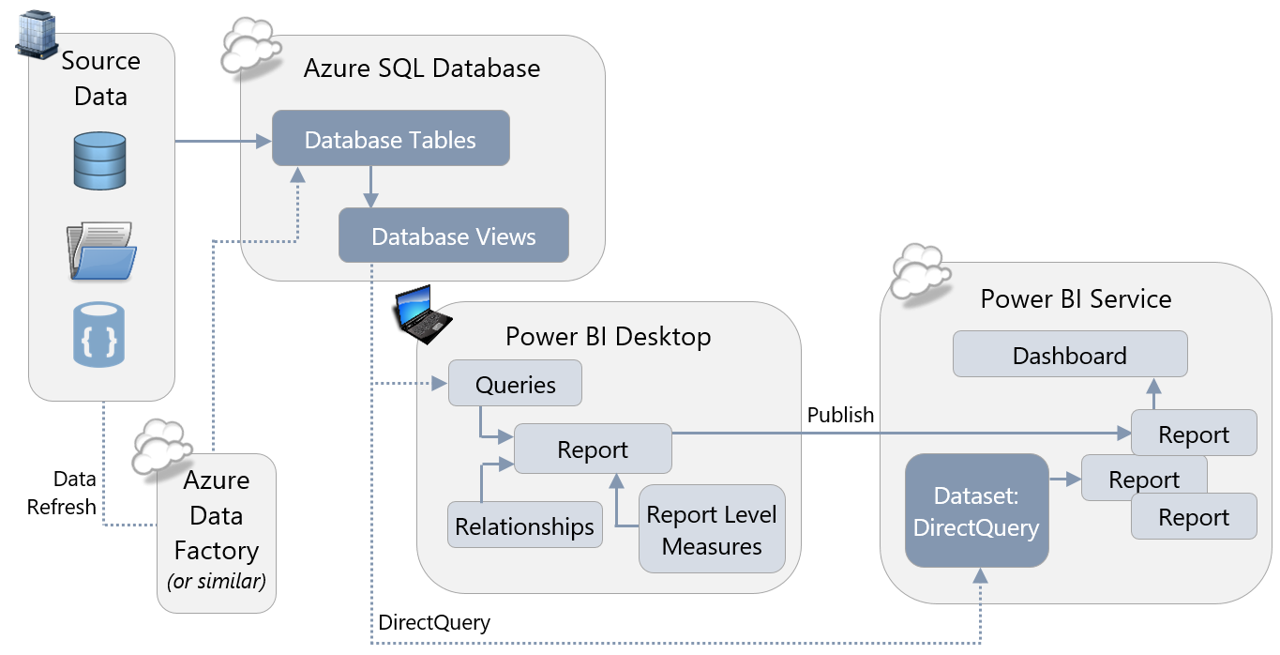
DirectQuery Mode

Slide 60
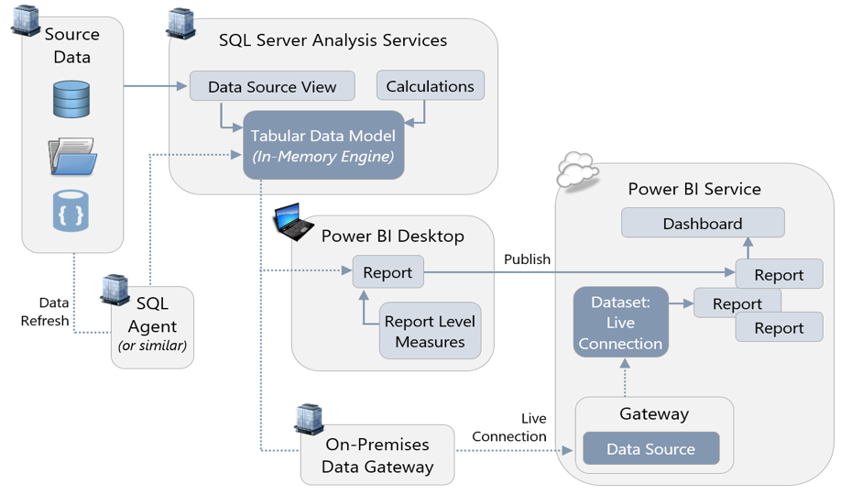
Live Data Connection to SSAS Tabular
Notes:
The database engine that Power BI uses to store imported datasets is, essentially, the same engine that runs inside Analysis Services Tabular models. As a result, Power BI can use SQL Server Analysis Services, or Azure Analysis Services, as a place to store the data needed for reports instead of using imported datasets. In this situation, DAX queries are issued via a live connection back to Analysis Services whenever a report is rendered. Any version and edition of SQL Server Analysis Services Tabular, and any tier of Azure Analysis Services, can be used in live connection mode.

Slide 61
Composite models
Hybrid of Importing data and DirectQuery
Allows for slower changing data to be cached through Import
Data must be refreshed using Dataset Schedule
Allows rapid changing data to be accessed through DirectQuery
Queries are passed through natively to data source
Can have performance impact
Provides real-time view of data source at query time

Slide 62
Resources and Whitepapers
Planning a Power BI Enterprise Deployment Whitepaper - https://aka.ms/pbienterprisedeploy
Planning Large-Scale Power BI Deployments - https://www.youtube.com/watch?v=PgS2kuD94xA
Enterprise BI deployments and governance with PowerBI - https://www.youtube.com/watch?v=K-zEWICvICM
Power BI Governance and deployment approaches - https://docs.microsoft.com/en-us/power-bi/service-admin-governance

Slide 63
Resources
Power BI Documentation
https://docs.microsoft.com/en-us/power-bi/
Power BI Guided Learning
https://docs.microsoft.com/en-us/power-bi/guided-learning/
Power BI Webinars
https://docs.microsoft.com/en-us/power-bi/webinars
Power BI Whitepapers
https://docs.microsoft.com/en-us/power-bi/whitepapers
Power BI Blogs
https://powerbi.microsoft.com/en-us/blog/

Slide 64
Pair Power BI with Microsoft Information Protection and Microsoft Cloud App Security to better protect Power BI data
Apply sensitivity labels familiar in Office 365 apps like Word, Excel, PowerPoint, and Outlook to Power BI data.
Extend protection and governance policies to Power BI data—including exported data—with Microsoft Information Protection.
Better meet privacy and regulatory requirements with oversight of sensitive data through Microsoft Cloud App Security.
Help prevent exposure of sensitive data by blocking risky user activities, in real time, with Microsoft Cloud App Security.
Notes:
Power BI Data owners can apply consistent policies and labels on sensitive data across Office 365 and Power BI
Meet privacy and regulatory requirements
Oversight over where sensitive data is stored and who accesses it
Effectively consume data while abiding security and compliance policies
Enable data owners to protect the data according to organization policies
Prevent unauthorized access to data that was exported from Power BI and reduce the risk of data leakage
Admins can use MS world leading Cyber Security products to monitor and protect data in Power BI as well as Office 365

Slide 65
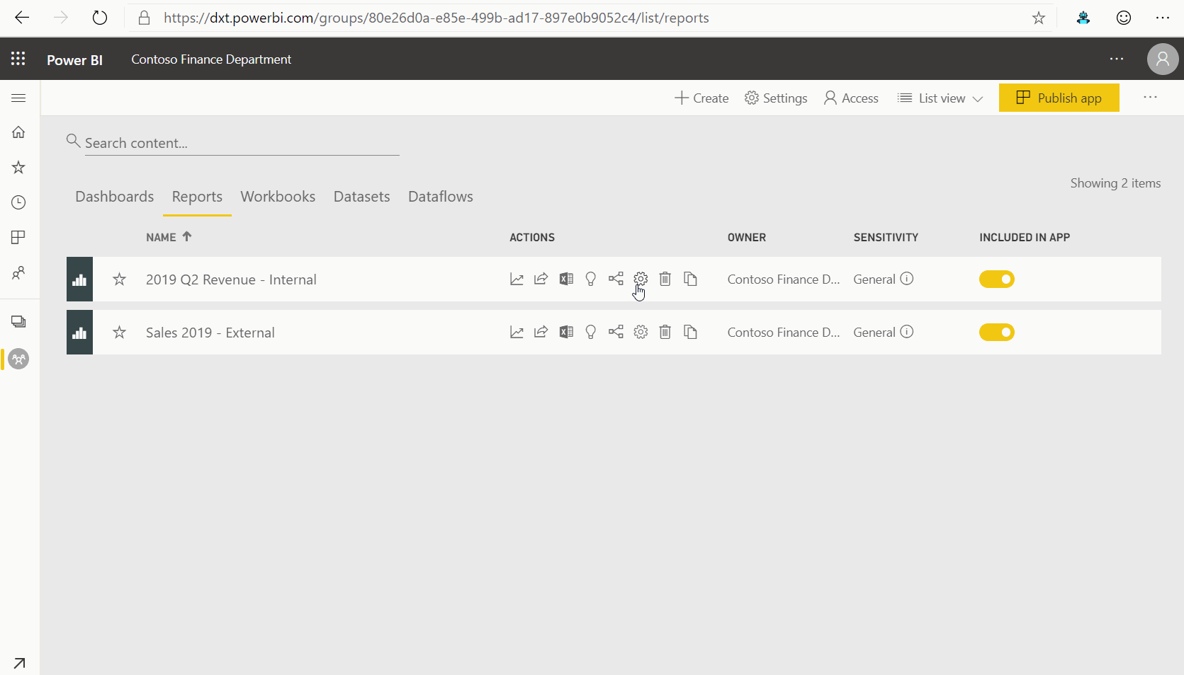
Classify and label Power BI artifacts
Classify and label Power BI artifacts
Data owners set Microsoft information protection (MIP) sensitivity labels for datasets, reports, dashboards and dataflows.
Same labels used to classify Office 365 files.

Slide 66
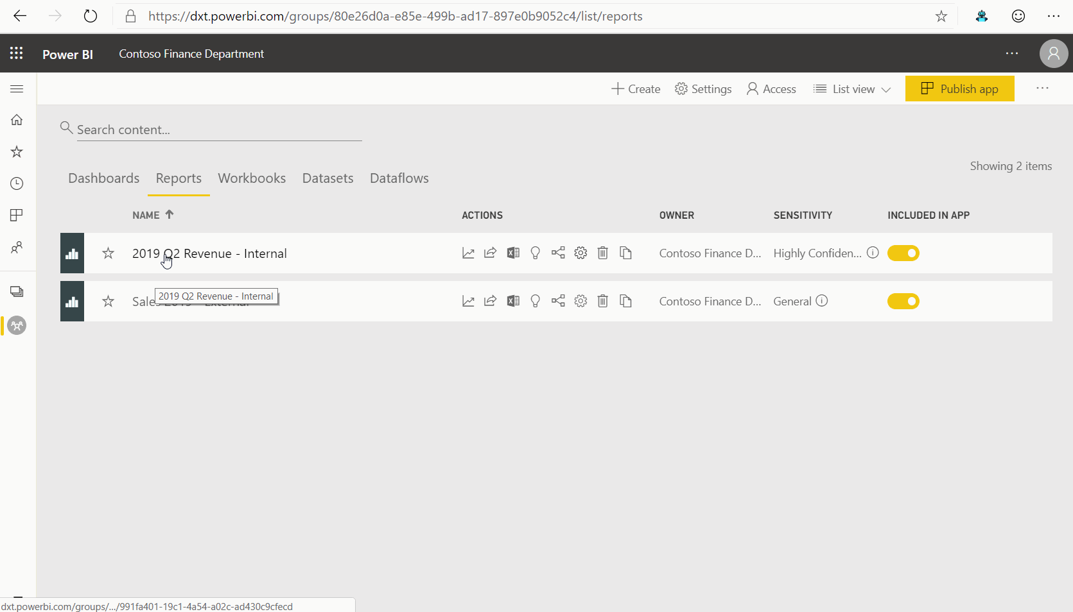
Protect data exported from Power BI
Sensitivity labels of Power BI artifacts persist in files exported from Power BI to Excel, PowerPoint, PDF (at preview).
Data protection policies defined by security and governance admins in Microsoft 365 portal are inherited when data is exported from Power BI service.
Prevent unauthorized access to sensitive data.

Slide 67
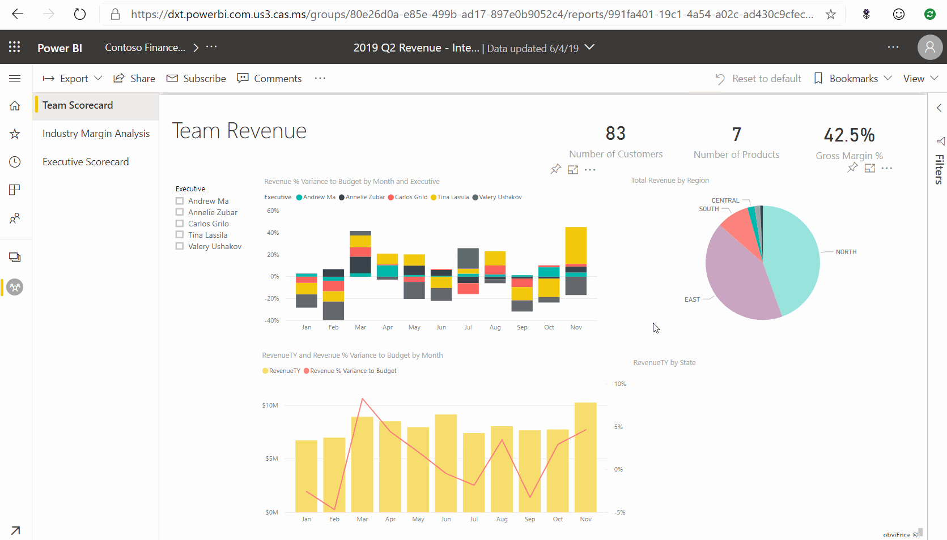
Protect data with real-time risk analysis
Admins can closely monitor risky sessions connecting to Power BI service in MCAS.
Security admins can define real time remediation of risky activities using MCAS real time controls.

Slide 68
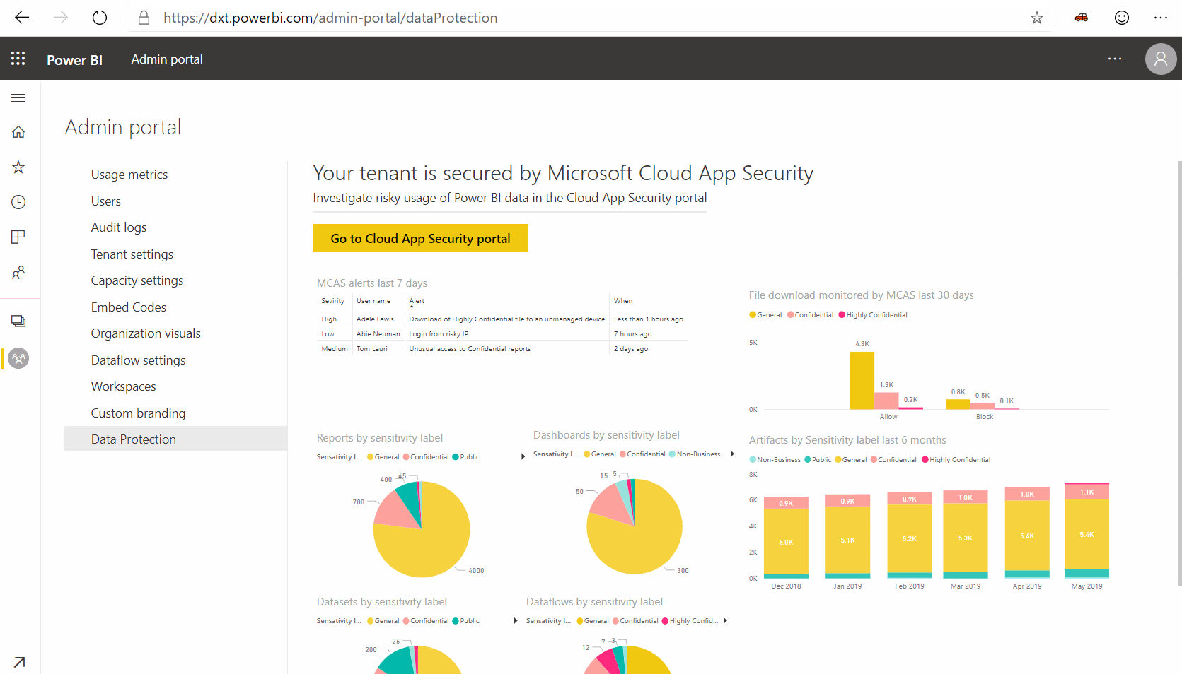
Enable admin oversight of sensitive data
Power BI admins have full visibility to sensitive data in their Power BI tenant and who consumes it (launch Jan 2020).
Security admins can use MCAS to gain better visibility for sensitive data usage in Power BI and investigate potential security risks.

Slide 69
Licensing
Licensing
Power BI + Azure Information Protection & Microsoft Cloud App Security license are required for users to take advantage of the capabilities shown.
* Note – Microsoft Information Protection is the brand name of the functionality, but Azure Information Protection is the name of the SKU.

Slide 70
Scenarios for using the CDM

Slide 71
But what if…
Reports & dashboards
…we want to leverage the data created by the dataflow in applications or services outside of Power BI?
Datasets
Dataflows
Storage

Slide 72


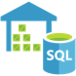

Data + AI professionals can use the full power of the Azure Data Platform
Reports & dashboards
Azure Data Factory
Azure Databricks
Azure SQL DW
Azure ML
Datasets
Dataflows
Azure Data Lake Storage Gen2
CDM folder
CDM folder
CDM folder
Data scientists Data engineers
Low to high code
Business analysts
Low/no code

Slide 73

But what if…
Reports & dashboards
…we want to leverage the data created by the dataflow in applications or services outside of Power BI?
…or to provide an easy way to consume analytical data created outside of Power BI, in Power BI?
Datasets
Dataflows
Storage

Slide 74

Deliver ready-made insights to Power BI users from Azure
Self service customizations
in Power BI
Dynamics 365 for Finance & Operations
Azure Data Factory
Azure Databricks
Azure SQL DW
Azure ML
Dataflow
Dynamics 365 data
Azure Data Lake Storage Gen2
CDM folder
Notes:
Challenge: Provide customers with great ready-made insights in the product –and enable unconstrained self service customizations
Dyn365F&O offers best in class ready-made Analytics embedded within the product.
Provide customers with no-cliffs extensibility: Within minutes, Power BI customers should be able to extend solutions leveraging data, reports and dashboards from Dyn365F&O as well as other systems
Extensibility of existing solutions is possible at two levels
Build customization experiences within your application
Enable customization and personalization experiences within the product for users of the App
Data is still contained within the application, not visible to other applications and services
Mashing up with data from other applications and services is not possible
Make data available to applications that specialize in customizations
Leverage the power of rich, robust experiences that Power users and developers are familiar with
Allows integrating data from multiple sources including Web and IoT sensors
Customers may need to copy the data over multiple times or set up ETL infrastructure and storage to make it available
Operations and Finance + Power BI + Dataflows win, because companies can:
Quickly deploy Power BI template with customizable Reports, Dashboards with data in CDM format
Customize or enhance the templates with data from other apps or sources using Power Bi’s rich connectors
Deploy other solutions that depend on schematized data with common or custom data model without any ETL required

Slide 75






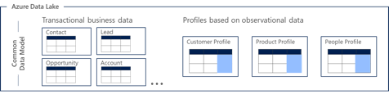
Enabling low friction collaboration among Data + AI professionals
Business analysts
Low/no code
Data scientists, Data engineers
Low to high code
Power BI
Dynamics 365
Azure IoT
Azure Data Services
data cataloging, data prep, AI, machine learning, data warehousing
ISV partners
Informatica,
etc.
Custom LOB + Developer resources
Power BI
dataflows
CDS for Apps data
Azure Data Lake Storage Gen2
CDM folders

Slide 76




Integrating CDM Folders with the Modern Data Warehouse
Azure Data Services
Azure Databricks
Azure Machine Learning
Azure Data Warehouse
Azure Data Factory
Azure Data Lake Storage Gen2
CDM folders

Slide 77
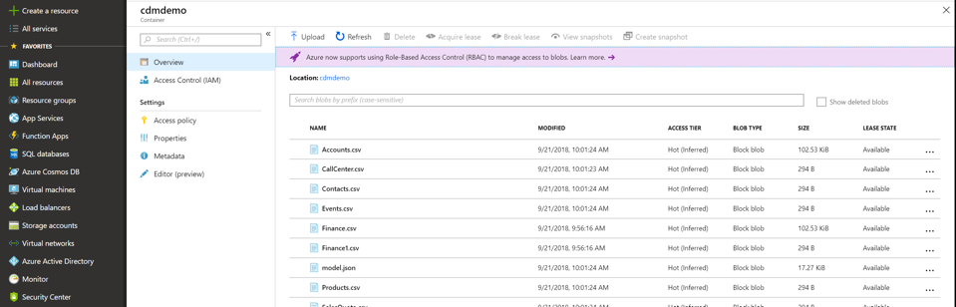
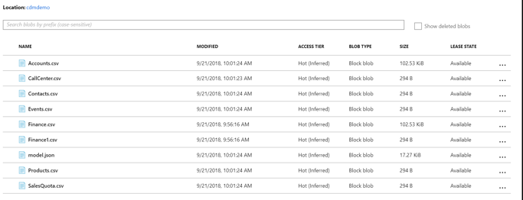
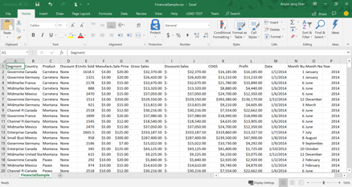
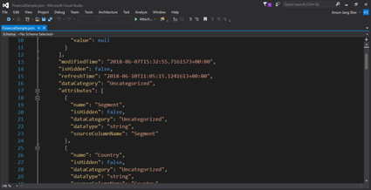
Integrating CDM Folders with the Modern Data Warehouse
salescdmfolder

Slide 78
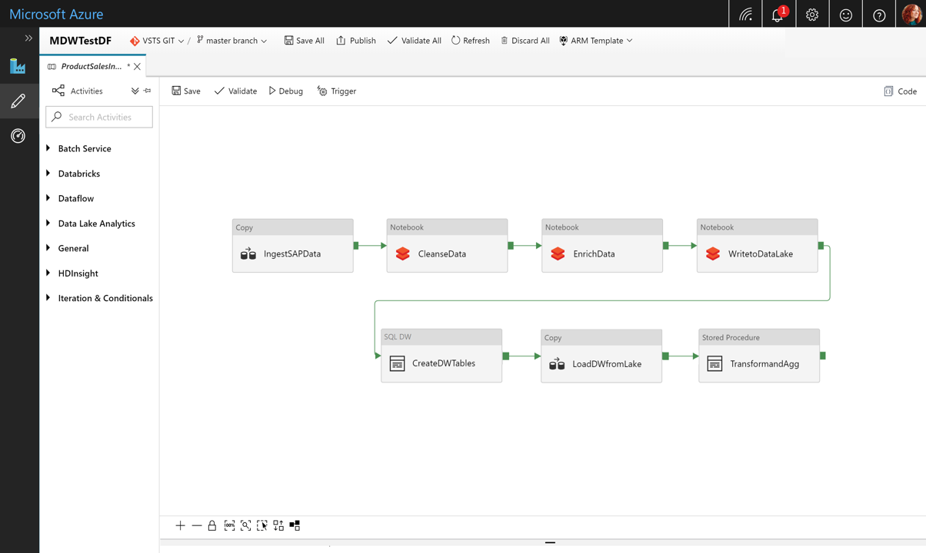
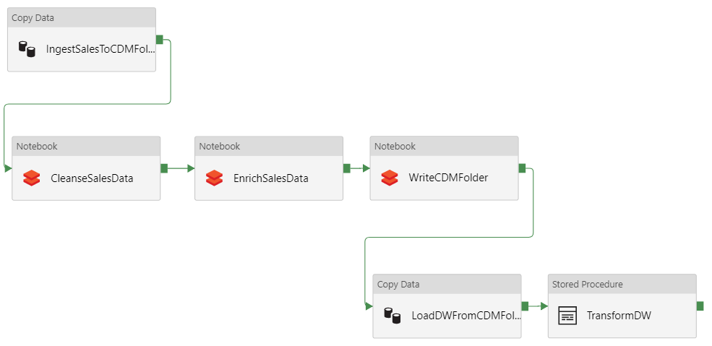

MDWSalesPipeline

Slide 79


